Slide 2
KWL Chart All About Mexico
What I know | What I would like to know | What I have learned

Slide 3
Mexico’s History Timeline
1500-400 BC: Mexico’s first major civilization, the Olmecs, emerge.
AD 300-900: Classic Period: Teotihuacán and Mayan
civilizations thrive.
1325-1428: The Aztecs migrate to Mexico’s central valley and gradually establish as the most powerful force in central Mexico.
1517: The first Europeans visit Mexico.
1519-1521: Hernán Cortés arrives with troops and conquers Mexico. The Aztec capital of Tenochtitlan is destroyed. Mexico City is rebuilt on the remains.
1521-1820: Mexico is under Spanish rule and is included in the Viceroyalty of New Spain.

Slide 4
Mexico’s History Timeline
1810-1821: The “Cry of Dolores” spoken by Catholic priest, Miguel Hidalgo y Costilla, sparks revolt against Spanish control. The Mexican War of Independence rages on until 1821.
August 24, 1821: Mexico finally gains independence from Spain in 1821.
1846-1848: Mexican-American War.
1910-1920: Mexican Revolution ends in the establishment of a constitutional republic.
1942: Mexico declares war on Germany and Japan.
1968: Mexico hosts the Olympic Games.
1985: Massive earthquake hits Mexico City, approximately 10,000 were killed.

Slide 5
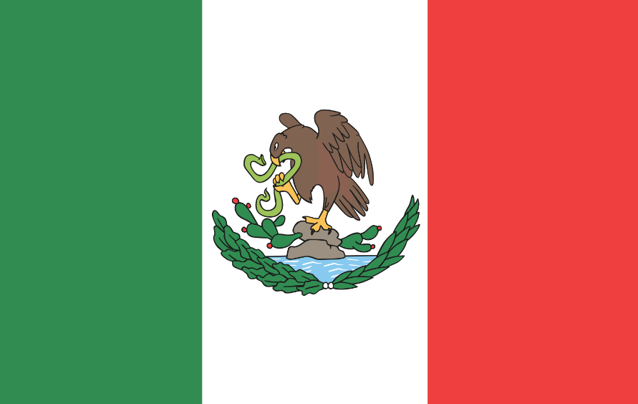
Mexico’s Flag
Green, white, and red with the national coat of arms in the center of the white stripe.
Green Stripe: hope
White Stripe: unity
Red Stripe: blood of heroes

Slide 6
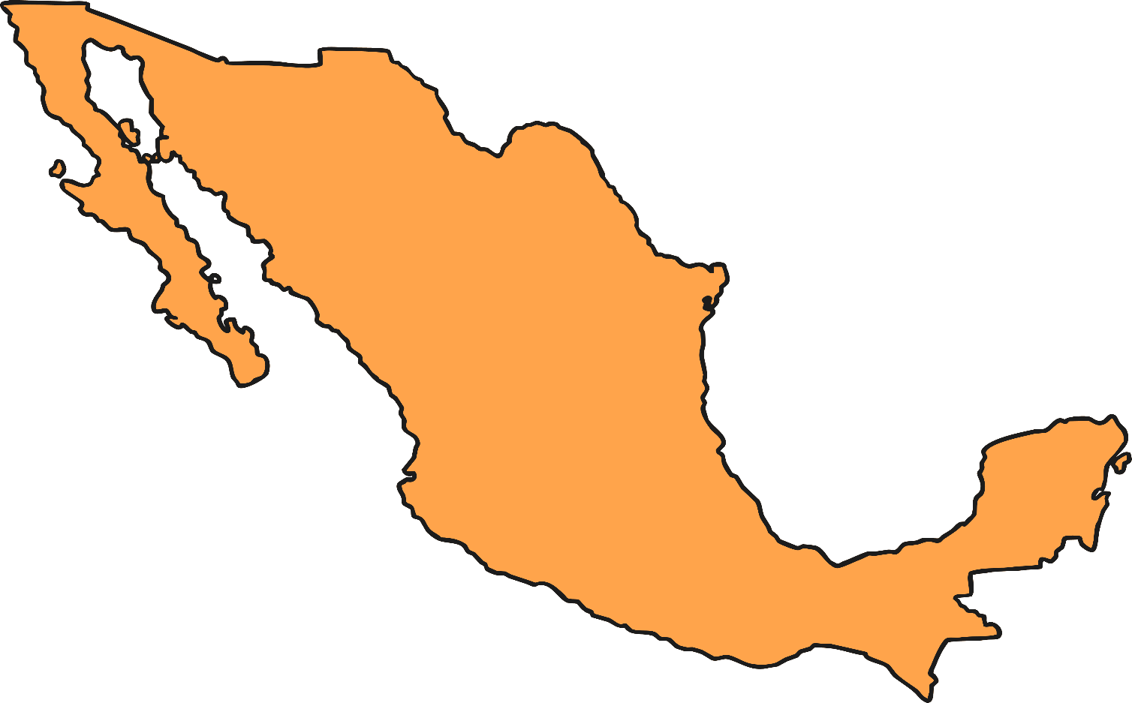
Mexico’s Geography
Located on the continent of North America
Official name is United Mexican States
Capital City: Mexico City

Slide 7
Mexico’s Geography
Third largest country in Latin America
14th largest nation in the world
Borders the United States of America, Guatemala, and Belize
Surrounded by the Pacific Ocean, Gulf of Mexico, and the Caribbean Sea

Slide 8
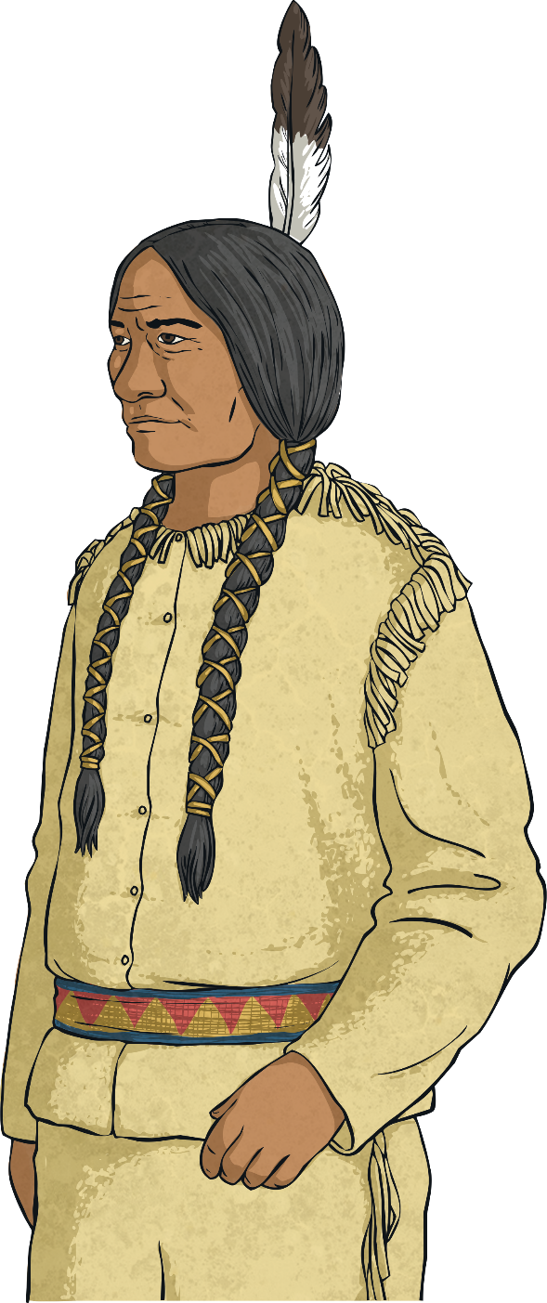
Mexico’s Geography
Capital: Mexico City
Most populated city in Mexico
Located in the Valley of Mexico
Oldest capital city in North and South America
Largest Spanish-speaking city in the world

Slide 9
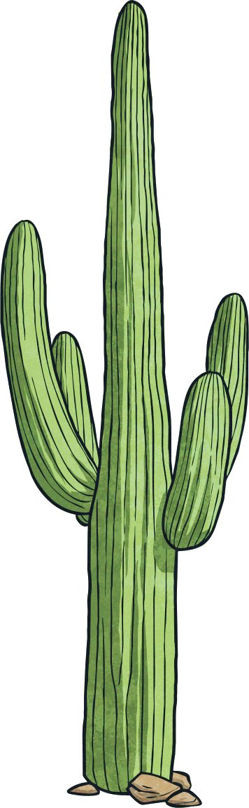
Physical Features
Copper Canyon: large group of canyons located in
northwestern Mexico includes Basaseachic Falls,
Mexico’s second-highest waterfall
Chihuahuan Desert: second largest desert in
North America
Lacandon Jungle: largest montane rainforest in
North America

Slide 10
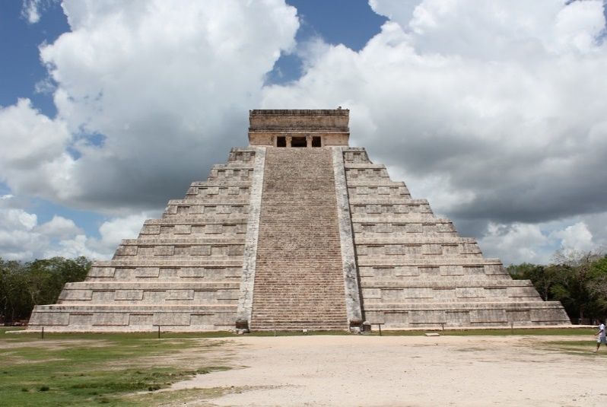
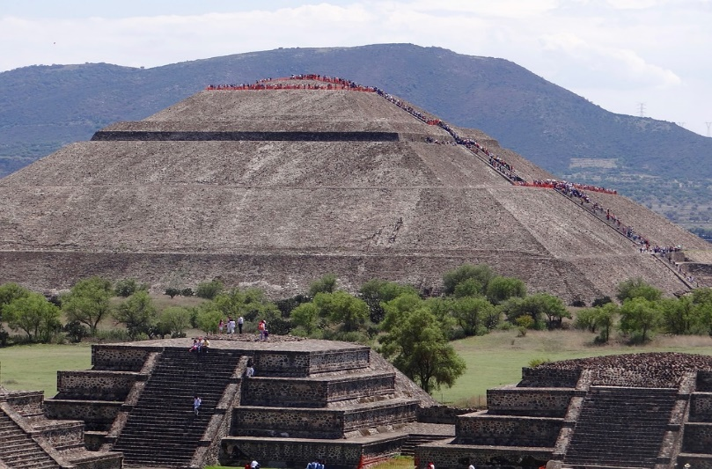
Landmarks
Chichen Itza: Mayan ruins located on the Yucatán Peninsula. Once one of the largest Maya cities and now one of the most visited archeological locations in Mexico.
Photo courtesy of Arian Zwegers (@flickr.com) - granted under creative commons licence – attribution
Teotihuacan: established in approximately 100 BC. It was the Aztec capital until it was conquered by Spain in 1521. Ruins of this beautiful city can still be seen in present day Mexico City.
Photo courtesy of Paula_Mondragon (@pixabay.com) - granted under creative commons licence – attribution

Slide 11
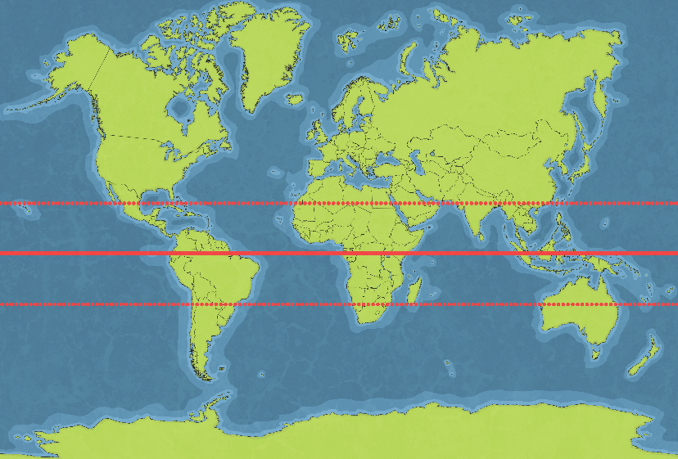
Climate
Mexico’s climate varies greatly depending on location.
The Tropic of Cancer divides the country into temperate and tropical zones.
  The area north of the Tropic of Cancer experiences a more varied climate including colder temperatures in the winter.
  The area south of the Tropic of Cancer is hot and humid and experiences only small changes in temperature.
Mexico also has dry and wet seasons.
  Wet Season: May-October
  Dry Season: November-April

Slide 12
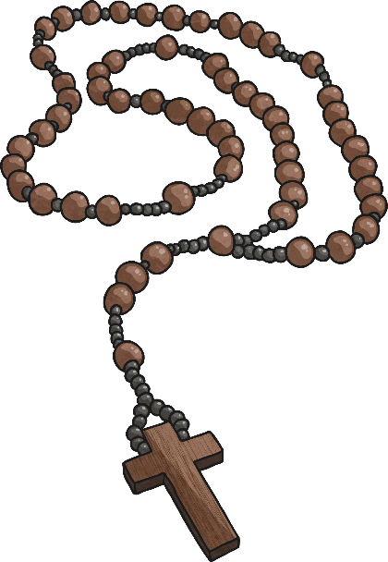
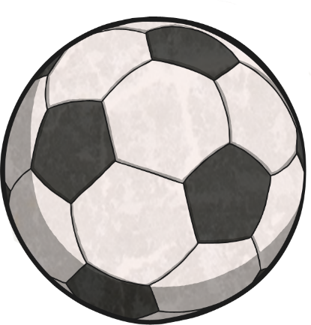
Culture
Spanish is the most spoken language in Mexico.
Mexico hosts the largest number of Native American language speakers in North America.
The largest religion in Mexico is the Roman Catholic religion.
Football is the most popular team sport in Mexico.

Slide 13
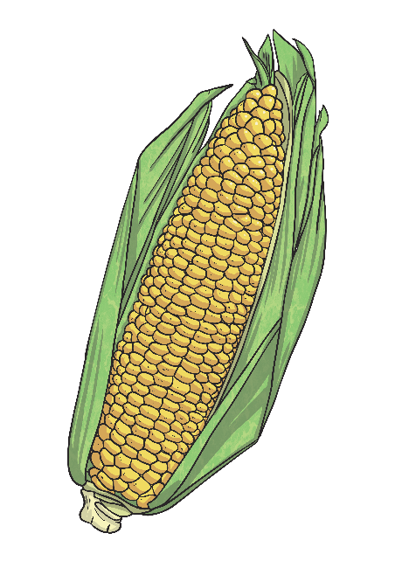
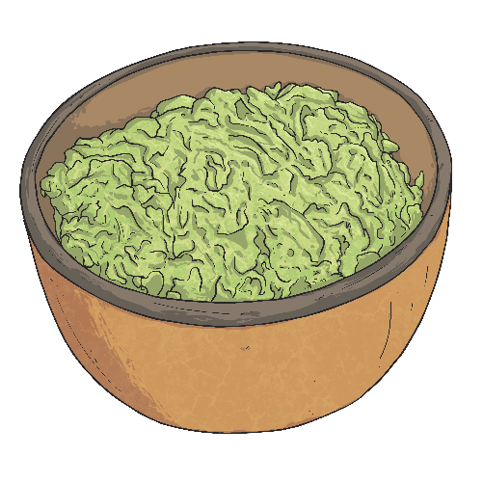
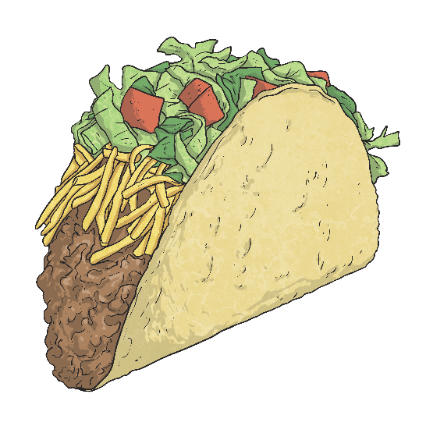
Mexican Food
Mole: a general name for a variety of different sauces used in Mexican cooking.
Corn is a very important staple in Mexican food. It is used in a multitude of Mexican dishes but most commonly in the form of tortillas.
Popular Mexican cuisine includes tacos, enchiladas, elote, guacamole, and tamales.

Slide 14
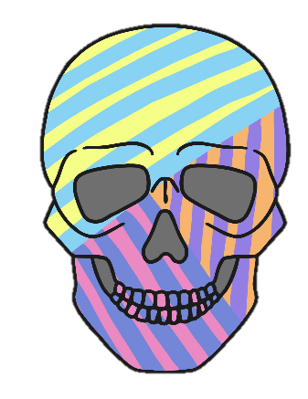
Holidays & Celebrations
Dia de los Muertos (Day of the Dead):
November 1st – 2nd each year.
A time to remember and celebrate loved ones who have passed away.
Altars are created and decorated with favorite items and food of the deceased as a way to entice them to return.
Sugar Skulls: one of the most well-known Day of the Dead decorations. These little decorations are typically made from granulated white sugar and decorated with bright patterns.
Calaca: these skeletons are a very popular Day of the Dead tradition. They are often adorned with marigold and foliage and are meant to be joyful rather than scary.

Slide 15
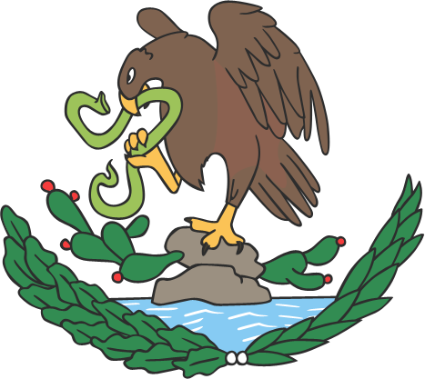
Holidays & Celebrations
Diez y Seis: Mexico’s Independence Day
September 16th
On September 16, 1810, Father Miguel Hidalgo
began a revolt against the Spanish rule.
Cry of Dolores: first spoken by Hidalgo in the town of Dolores,
it is considered to be the war cry of the Mexican War of Independence.
Celebrated with fiestas (parties) and celebrations similar to those of July 4th in the United States.

Slide 16
Would you like to travel to Mexico? Why or why not?

