Slide 2
Aim
I know why we need muscles to move.
Success Criteria
I can explain how muscles allow movement.

Slide 3
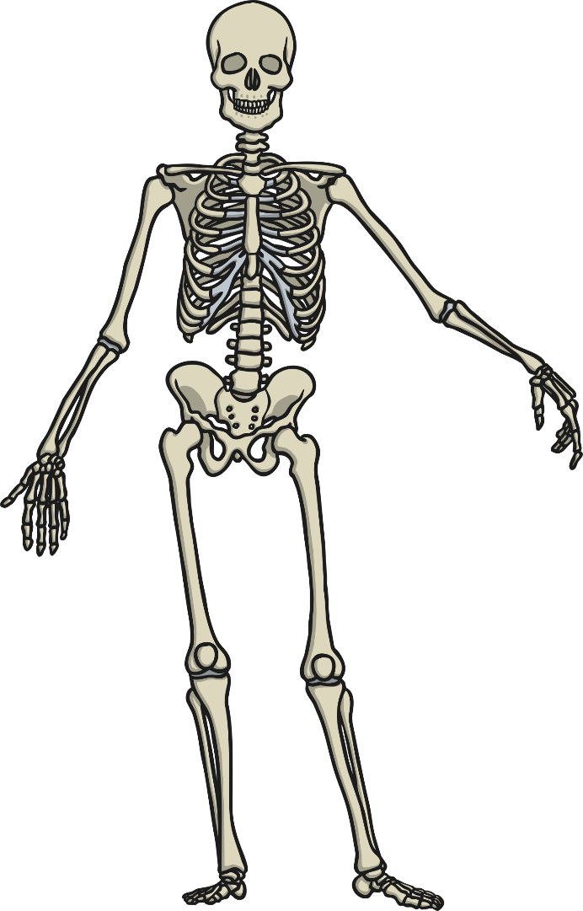
Movement
How do skeletons move the body? Discuss with your partner.
Can you tell your brain to move your leg?
A
B
Did your leg move? Why not?
Along with our bones, what else do we need to move our bodies?
C
D

Slide 4
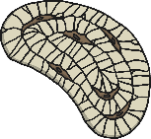
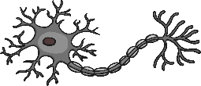
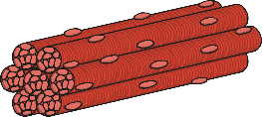
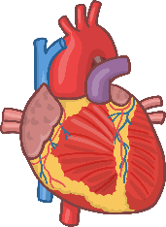
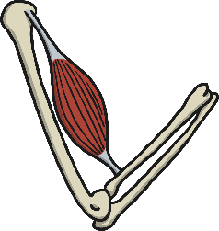
What are Muscles?
Our bodies are made up of different types of cells
smooth muscle cell
bone cell
nerve cell
Cells form to make tissue
Skeletal muscles are made up of just muscle tissue
Organs are made up of more than one type of tissue

Slide 5
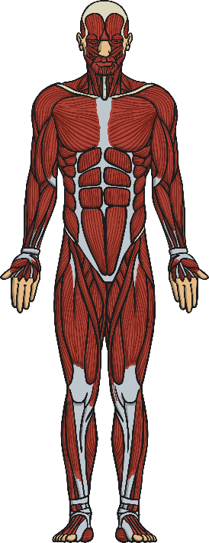
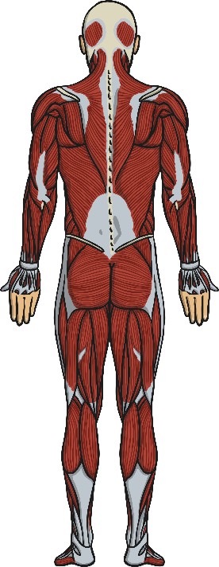
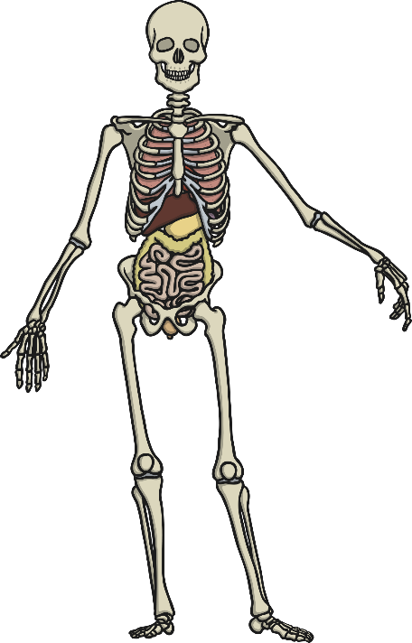
Mighty Muscles
A
C
Skeletal muscles are attached to bones and enable movement.
Some organs have muscle tissue. Which organs have muscles? (Hint: Think which organs move things around the body.)
B
D

Slide 6
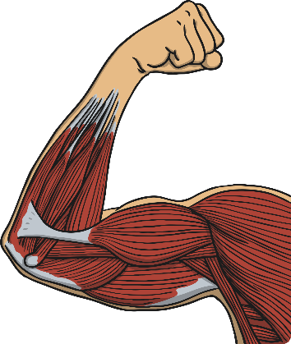
Voluntary and Involuntary
Some muscle movement is voluntary and we can control it. Other muscle movement is involuntary and we don’t have control over it.
Look at the pictures to the right: Which shows voluntary muscle movement and which shows involuntary?
Discuss with your partner and explain why you made your choice.

Slide 7
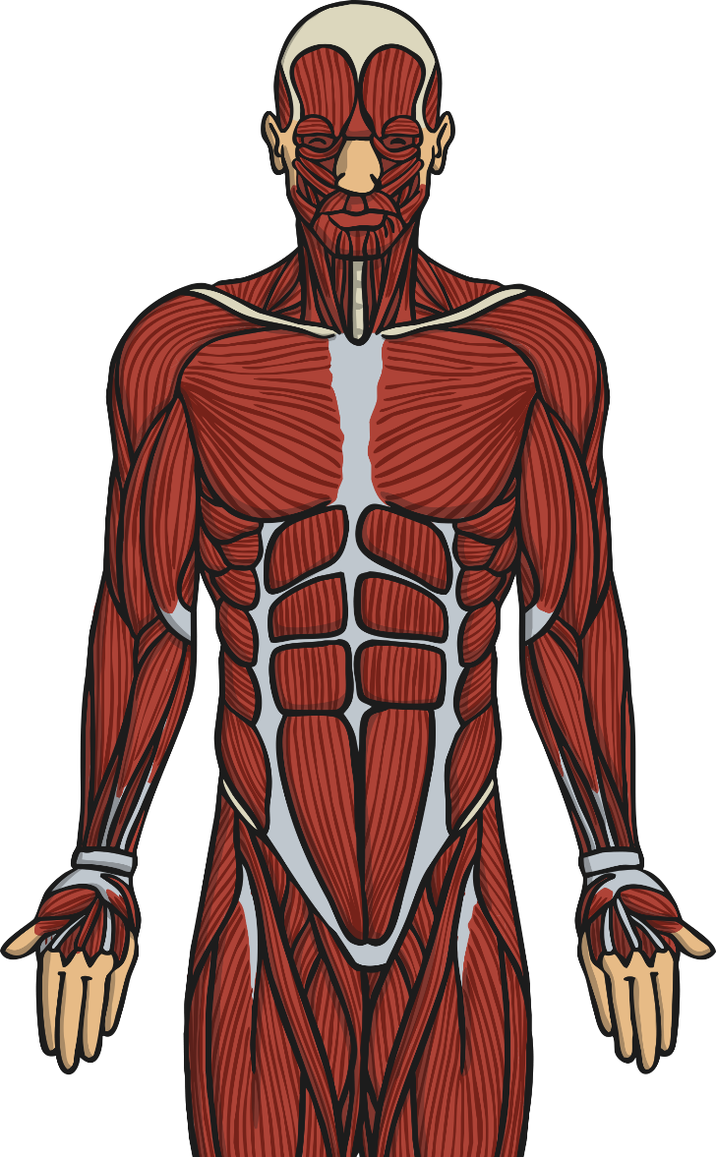
Two’s Company
Watch the following video and focus on the following:
Click me!
How do muscles move?
1
What words are used to describe the movement?
2

