Slide 2
Aim
I can tell you about the artist Leonora Carrington.
I can make a dream catcher.
Success Criteria
I can tell you the names of some of Leonora Carrington’s artworks.
I can tell you facts about Leonora Carrington’s life and work.
I can share something interesting about her work.

Slide 3
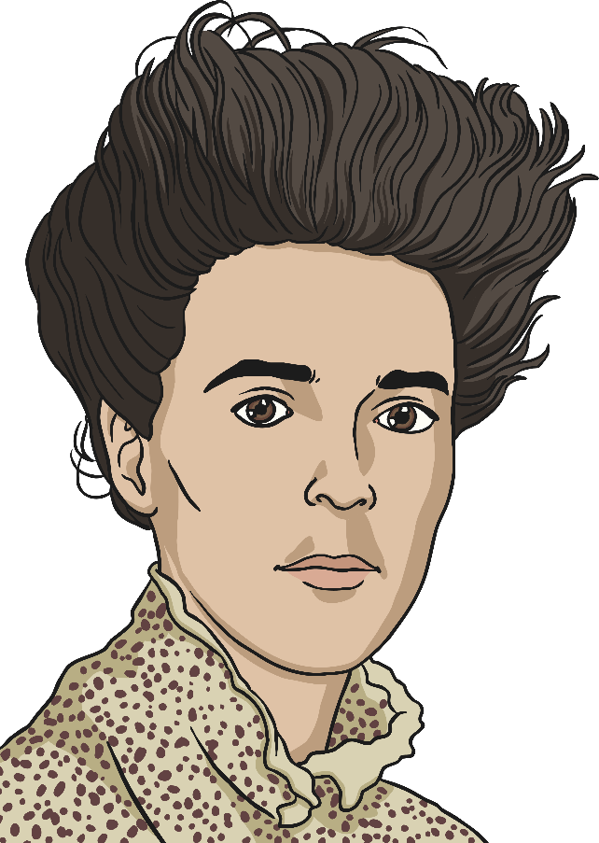
Leonora Carrington

Slide 4
Leonora Carrington (1917-2011)
Leonora Carrington was an artist and a writer, although she was also involved in making murals, textiles, costumes, poems and masks.
She was born in Britain but lived most of her life in Mexico. There she was very famous and popular. She is viewed as a Mexican artist because of this. Carrington painted dream-like images, using fantasy characters.
She came from a very wealthy British family in Lancashire, but left home when she was 20. She felt more comfortable with her artist friends.
She loved animals and often featured them in her work. Her love of nursery rhymes and fairy tales can be seen in her paintings.

Slide 5
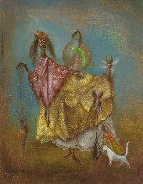
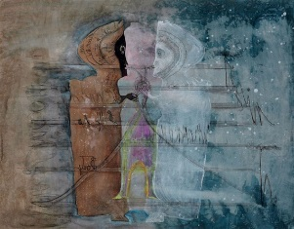
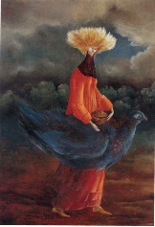
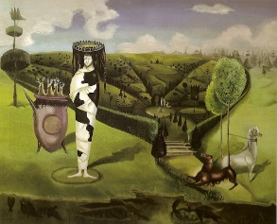
Looking at Paintings
Look at your image.
What can you see in the picture?
Where is the painting set?
How does the picture make you feel?
What colours can you see in the picture?
Why do you think the artist painted it?
If you could give the painting your own title, what would it be?

Slide 6
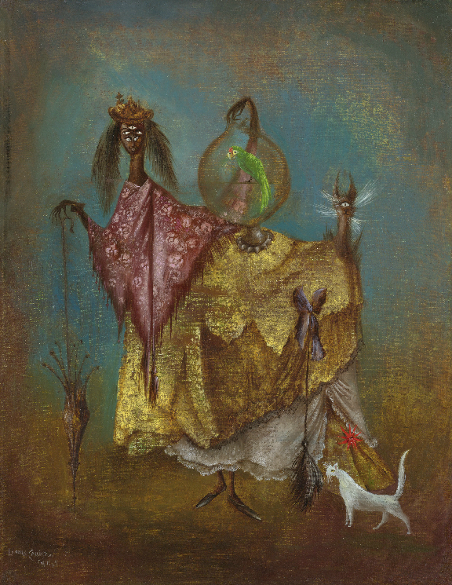
The Artist Traveling Incognito by Leonora Carrington
Photo courtesy of centralasia (@flickr.com) - granted under creative commons licence - attribution

Slide 7
Play Shadow by Leonora Carrington
Photo courtesy of www.wikiart.com- attribution

Slide 8
Portrait of the Late Ms Partridge by Leonora Carrington
Photo courtesy of www.wikiart.com- attribution

Slide 9
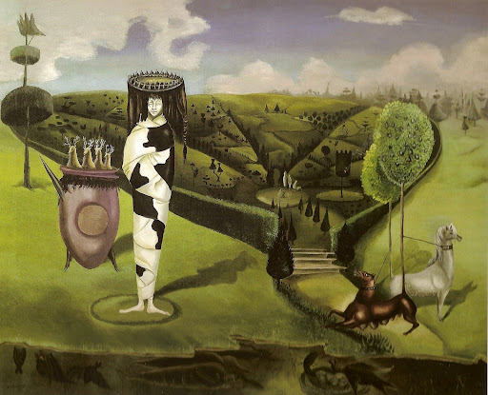
Green Tea by Leonora Carrington
Photo courtesy of www.wikiart.com- attribution

Slide 10
Leonora’s Dreams
Leonora Carrington’s paintings are often described as ‘dream-like’.
Weird and wonderful creatures and activities seem to be happening in her paintings.
Imagine that she could catch the dream you had last night. What do you think she would paint?
Photo courtesy of www.wikiart.com- attribution

Slide 11
Dream Catchers
Photo courtesy of Steven Leonti (@flickr.com) - granted under creative commons licence - attribution

Slide 12
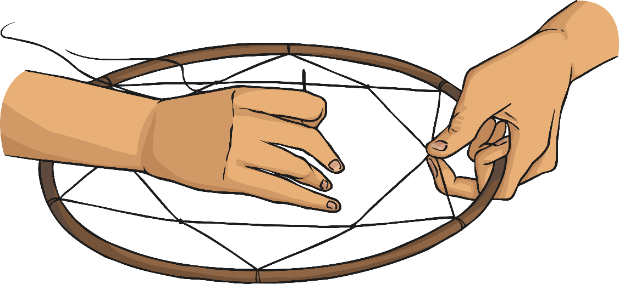
Your Task
Your job is to make your own dream catcher.
Think about the colours that the artist used in her paintings.
Use these in your dream catcher.

Slide 13
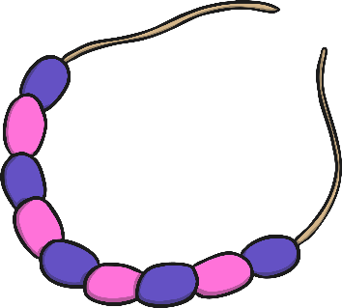
How to Make a Dream Catcher
You will need:
Paper plate ring (with holes punched)
Wool
Paints
Decorations such as beads, feathers etc…
With a pencil, lightly sketch a design onto your ring inspired by Leonora Carrington shapes and characters.
Paint your design.
Thread wool from one hole to another in any order you like. Make sure the wool crisscrosses the circle. As you thread, add beads to the wool to decorate.

