Slide 2
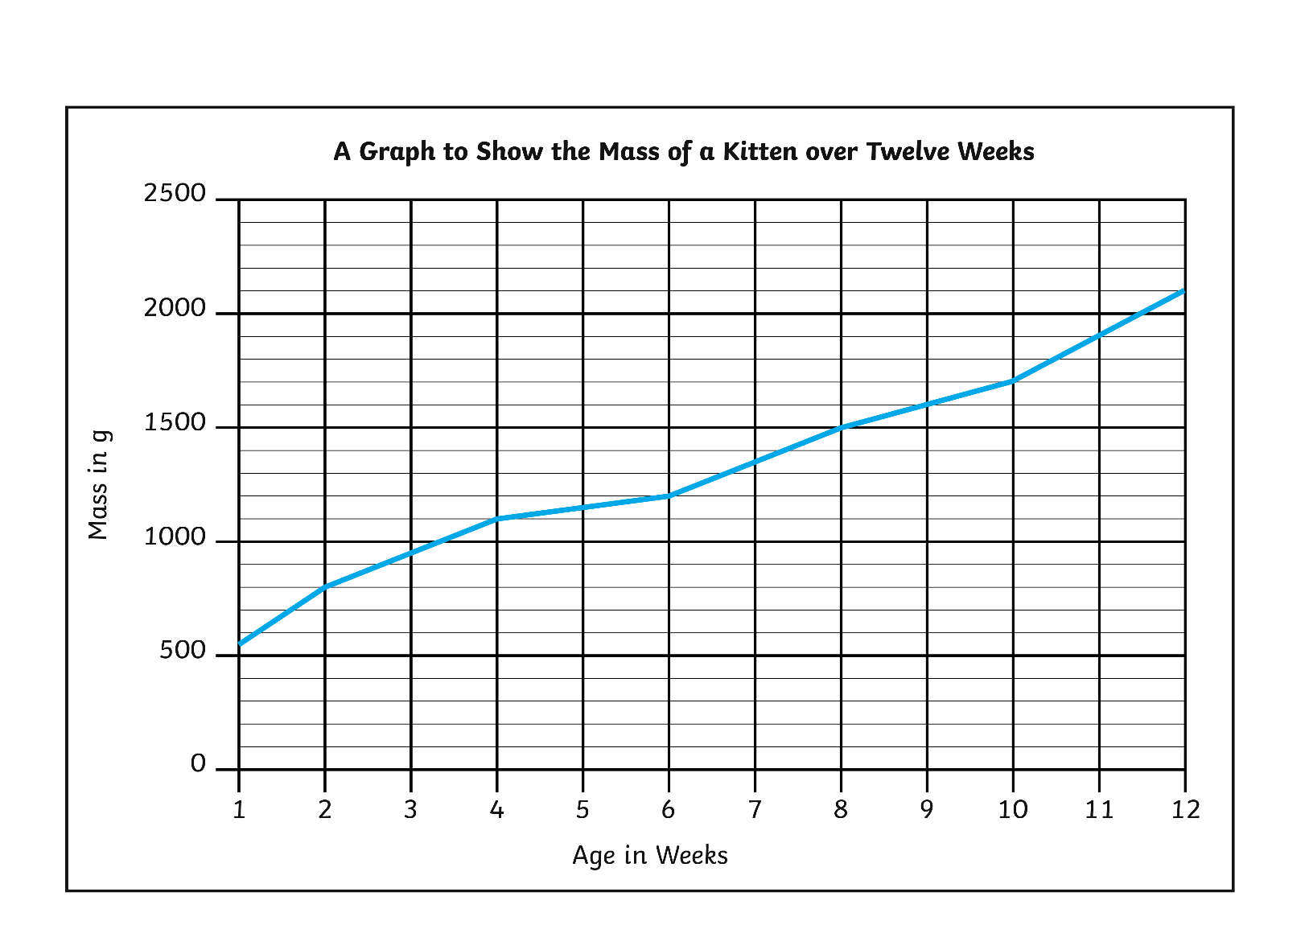
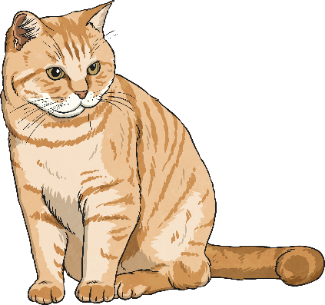
Line Graphs
Diving
3 and a half weeks or between 3 and 4 weeks
1350g
300g
What is the difference between its mass at 2 weeks and at 4 weeks?
When did the kitten reach 1kg?
What was the mass of the kitten at 7 weeks?

Slide 3
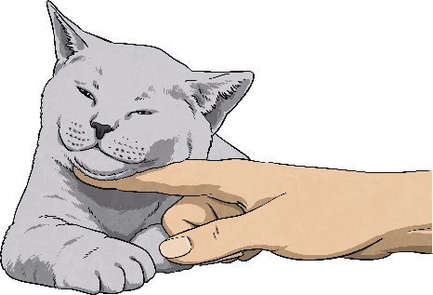
Line Graphs
Diving
A second kitten has a mass of 400g at birth and puts on 50g in a week. Where would we plot the first point on this graph?

Slide 4
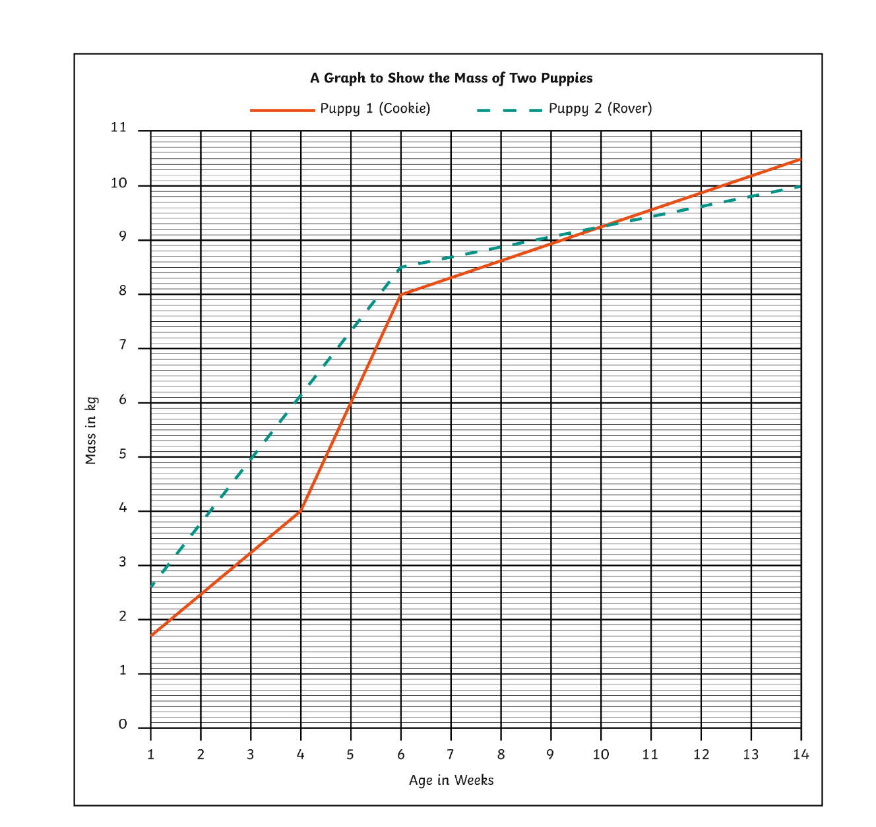
Line Graphs
Deeper
What is the difference between the mass of the 2 puppies at 7 weeks?
400g
When did Cookie become heavier than Rover?
After week 10

Slide 5
Line Graphs
Deeper
Discuss how Liz should have worked out which puppy gained the most mass.
Liz said, “Rover has gained the most mass. I know that because the biggest difference is at week 4 and he is heavier than Cookie in that week.”
Liz should have compared the difference between each puppy’s mass in week 1 and week 14.
Cookie
10.5kg – 1.5kg = 9kg mass gain
Rover
10kg – 2.5kg = 7.5kg mass gain
Cookie gained the
most mass.

Slide 6
Line Graphs
Deepest
How Far a Tortoise Walked around a Garden over Half an Hour
Discuss what you think happened to the tortoise over the course of the 30 minutes.

