Slide 1
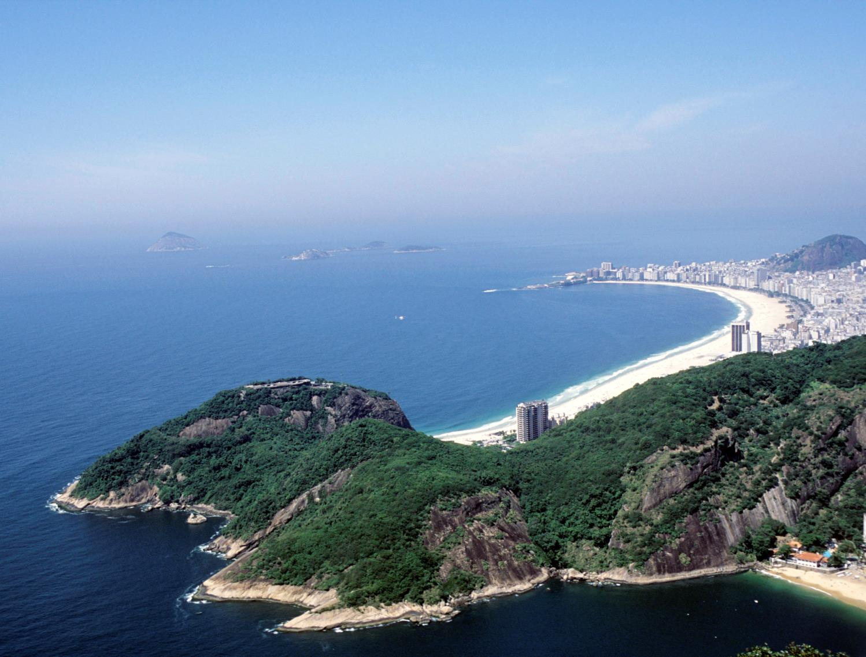
www.actionaidorg.uk/schools - April 2016
Notes:
Introduce your pupils to the fascinating country of Brazil through this interactive quiz.
Photo: Rio de Janeiro, Brazil - Jenny Matthews/ActionAid.

Slide 2
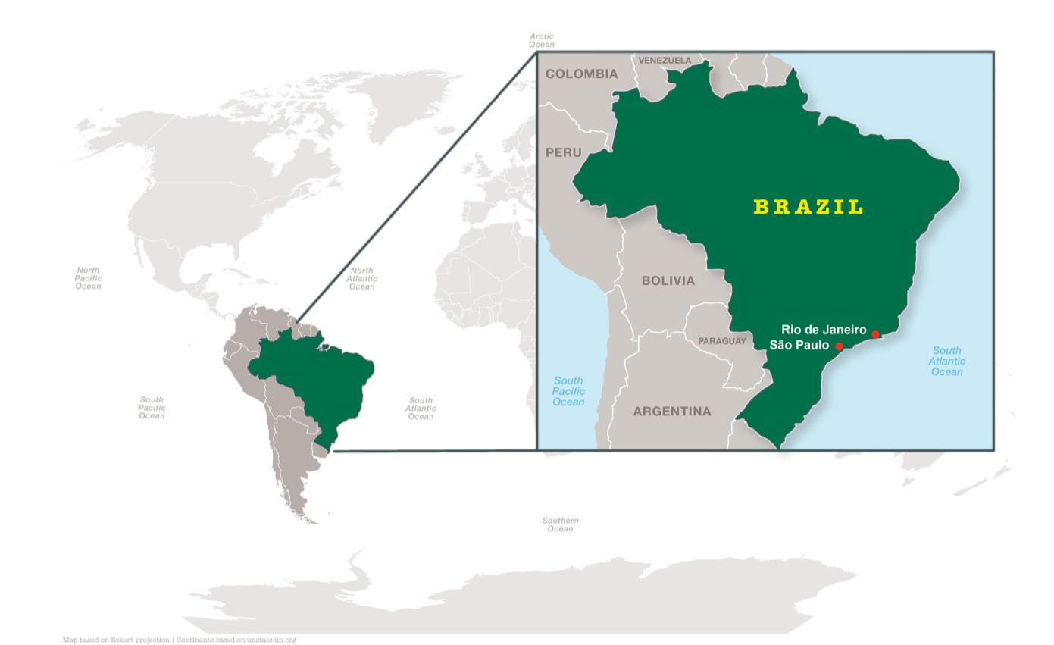
What continent is Brazil in?
South America
www.actionaidorg.uk/schools - April 2016
Notes:
Answer: South America.
South America is home to the world’s highest waterfall, Angel Falls in Venezuela; the largest river (by volume), the Amazon River; the longest mountain range, the Andes; the driest place on earth, the Atacama Desert; the largest rainforest, the Amazon Rainforest and the highest capital city, La Paz, Bolivia.
Brazil is the largest country in South America, covering around half of the continent’s land area and population. It is also the longest country in the World. Ecuador and Chile are the only South American countries that do not share a border with Brazil.
Brazil is the only Portuguese speaking country in the Americas (and the largest Portuguese speaking country in the world.)

Slide 3
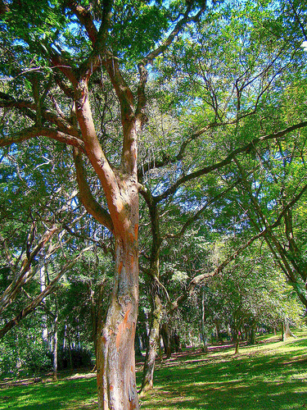
The Brazilwood tree
Where did Brazil get its name from?
The surname of the first Portuguese captain to land in Brazil
The Portuguese word for land
The Brazilwood tree
www.actionaidorg.uk/schools - April 2016
Notes:
Answer: C. The Brazilwood.
Brazil got its name from a tree - the “Brazilwood”. The Brazilwood was grown along Brazil's coast and was the first product to be sold to other countries.
Photo: Wikimedia Commons.

Slide 4
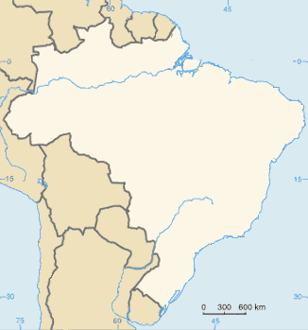
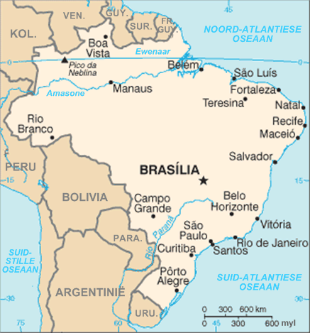
What is the capital of Brazil?
?
www.actionaidorg.uk/schools - April 2016
Notes:
Answer: Brasília.
The capital city is located among the Brazilian Highlands in the country's Central-West region. The city was founded in 1960 to serve as the new national capital. Brasília had an estimated population of 2,789,761 in 2013, making it the 4th most populous city in Brazil.
Maps: both Wikimedia Commons.

Slide 5
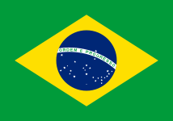
What do the different parts of the Brazilian flag mean?
A. The yellow represents the sun; the green farmland; the blue the coastline; and the stars are the major cities of Brazil.
B. The green represents the forests of the country and the yellow its mineral wealth. The blue represents the sky and each star is a different state.
C. Green, yellow and blue were the first Presidents favourite colours. Each star represents a different member of his extended family.
www.actionaidorg.uk/schools - April 2016
Notes:
Answer: B.
Brazil officially adopted this design for its national flag on November 19, 1889.
The green square and yellow rhombus, representing the forests and mineral wealth of Brazil, were preserved from the original flag. The colours also represent the reigning House of Braganza and the House of the Consort of the first emperor, Habsburg. The blue circle replaced the arms of the Empire of Brazil and contains 27 white five-pointed stars. Their positions reflect the sky over Rio de Janeiro on November 15, 1889 and each star represents a specific State, plus one for the Federal District.
The motto "Ordem e Progresso" ("Order and Progress") is inspired by Auguste Comte's motto of positivism:
"L’amour pour principe et l’ordre pour base; le progrès pour but" ("Love as a principle and order as the basis; progress as the goal").

Slide 6
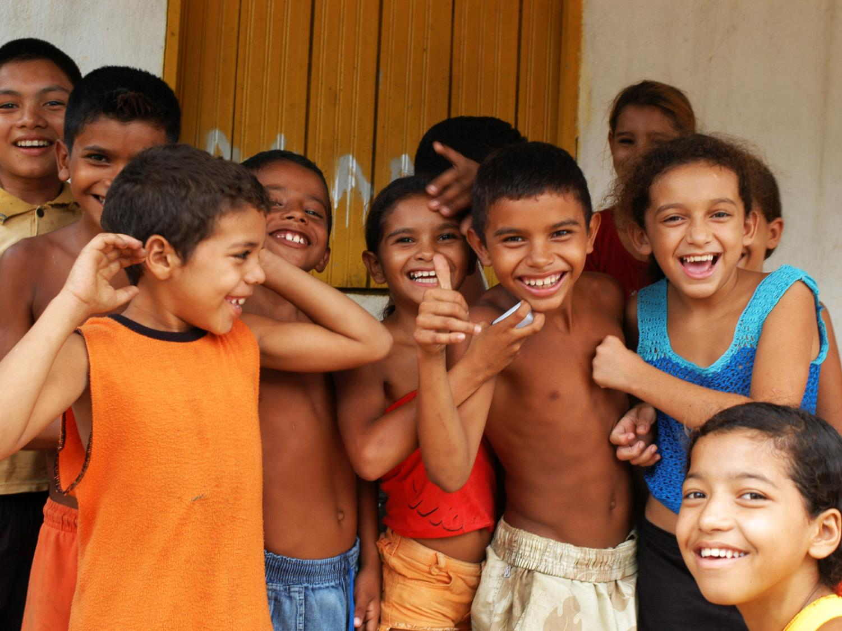
How do you say ‘Hello’ in Portuguese?
A. Bonjour
B. Tchau
C. Olá
Notes:
Answer: C. Olá.
Bonjour is ‘hello’ in French while tchau means ‘bye’ in Portuguese (adapted from the Italian word ciao).
Photo: Jenny Matthews/ActionAid.

Slide 7
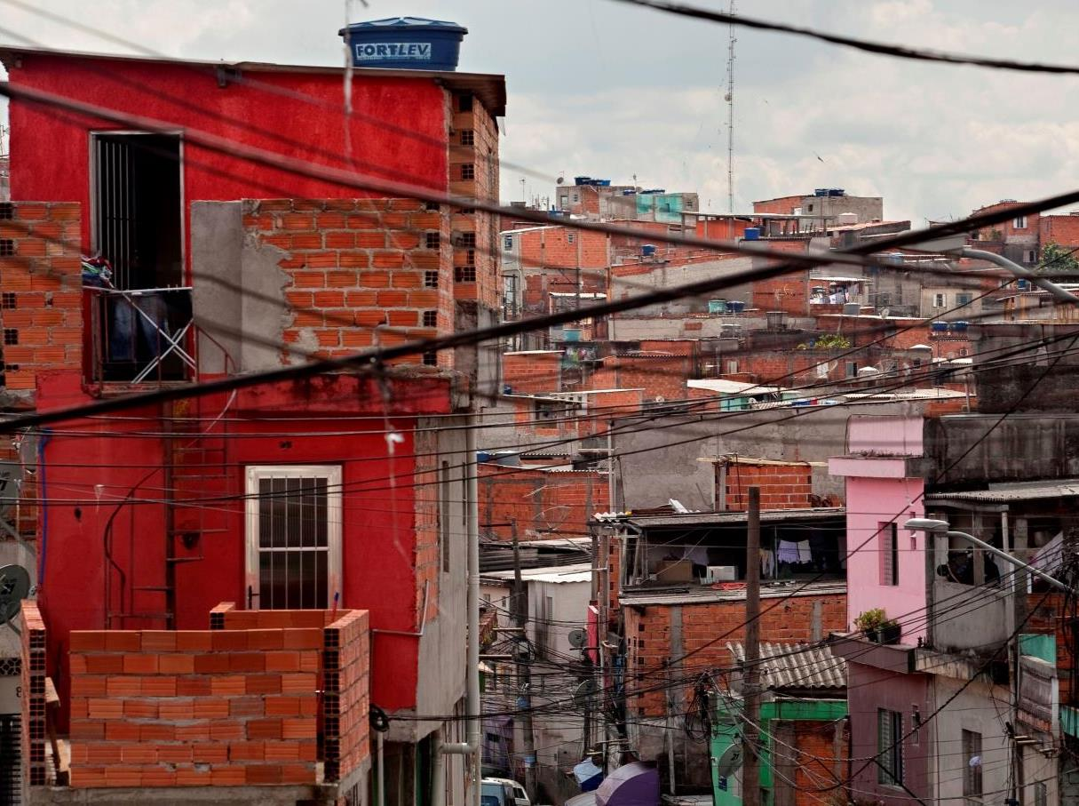
What percentage of Brazil’s population live in urban areas?
85%
25%
40%
www.actionaidorg.uk/schools - April 2016
Notes:
A. 85% of Brazil’s population live in urban areas.
Of that percentage, a large number of people from the big cities live in favelas - 1.1 million of Brazil’s poor. One in five Rio de Janeiro residents lives in a favela.
Source: http://apps.who.int/gho/data/node.country.country-BRA
Photo: Heliopolis, Sao Paulo, Brazil. Eduardo Martino/Documentography/ActionAid.

Slide 8
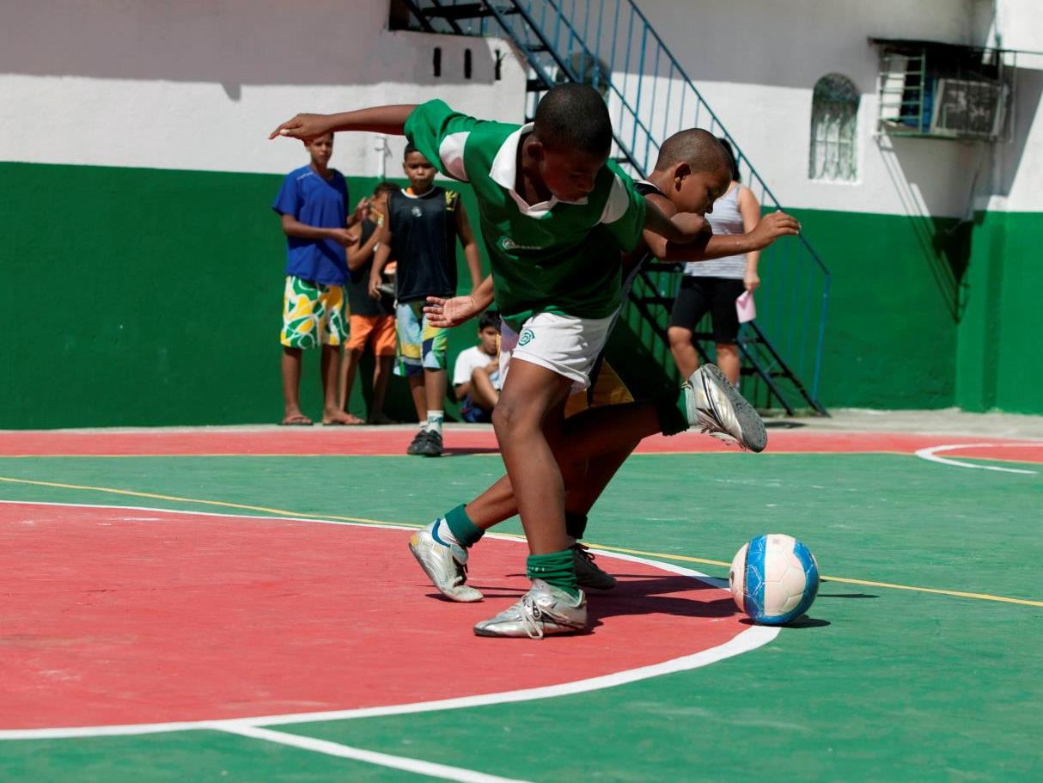
What is the most popular sport in Brazil?
Football
Capoeira (martial arts)
Footvolley (a beach sport)
www.actionaidorg.uk/schools - April 2016
Notes:
Answer: A. Football.
Football is the most popular sport in Brazil. The Brazilian national soccer team has won the FIFA World Cup a record 5 times: in 1958, 1962, 1970, 1994, and 2002. It is the only team to succeed in qualifying for every FIFA World Cup competition ever held.
Capoeira is an Afro-Brazilian martial art that is very popular in Brazil. It combines elements of dance and music. It is a culturally significant sport developed in colonial times by slaves.
Footvolley is one of the most popular beach sports in Brazil. It is a mix of football and volleyball, where the players must use their feet and head to get the ball over the net and into the opponent's court.
Photo: Children playing football at the Casa da Cultura in São João de Meriti, Brazil. Credit: Eduardo Martino/Documentography/ActionAid.

Slide 9
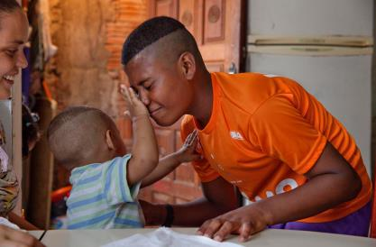
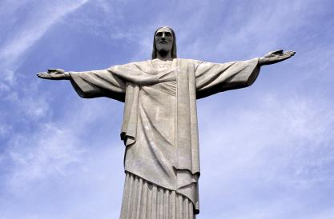
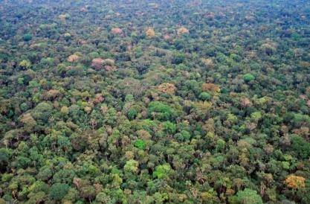
Find out more about life in Brazil
Why not find out more about Brazil with some of our other resources?
Brazil stories: meet the children living in Brazil
Explore Rio de Janeiro
Explore the Amazon rainforest
www.actionaidorg.uk/schools - April 2016

