Slide 2






What Is COVID-19?
COVID-19 is a virus. It has spread around the world and made lots of people unwell. The virus is very small and can’t be seen without a powerful microscope.

Slide 3

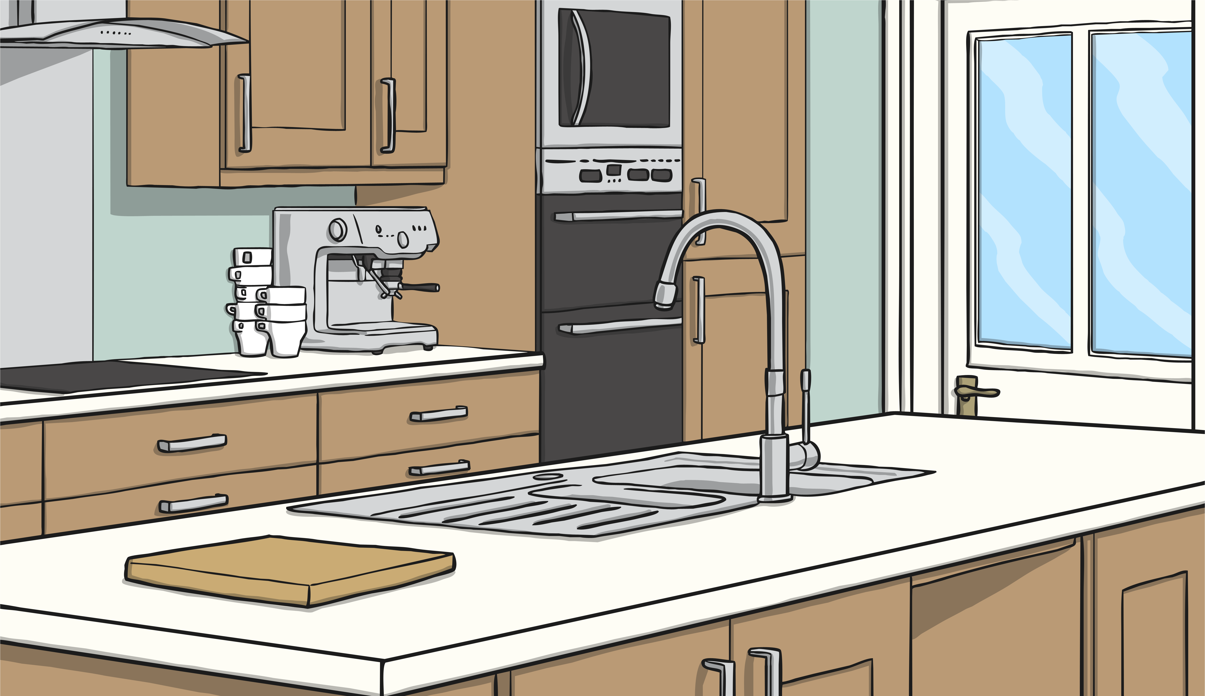

How Does COVID-19 Spread?
When someone with COVID-19 coughs or sneezes, the virus can get into the air and onto surfaces beside them. If other people touch these surfaces, the virus can be on their hands. When they touch their face with their hands or eat without washing their hands, the virus can get inside their body and make them unwell.
If a person is close to someone with COVID-19 who coughs or sneezes, they could breathe in the virus.

Slide 4
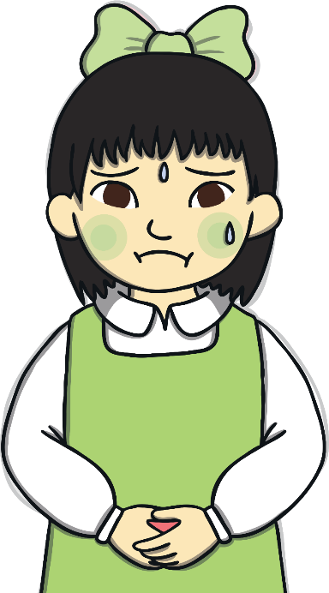
How Does COVID-19 Make People Feel?
COVID-19 can cause a high temperature, a sore throat and a cough.
A smaller number of people feel very ill and need to go to hospital.
Most people feel unwell for a few days and get better at home with lots of rest.
Other people won’t feel ill at all but can still pass the virus on.

Slide 5




How Can We Stop the Virus From Spreading?
We can all help to stop the virus from spreading by:
Socially distancing
Washing our hands
Staying at home if we have a high temperature, a sore throat or a cough

Slide 6


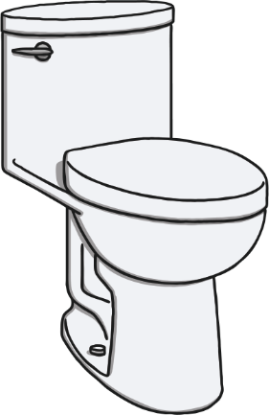
Washing Our Hands
We should wash our hands for at least 20 seconds lots of times every day using soap and warm water. It is especially important to wash our hands at these times:
Before we eat
When we come into our houses from being outside
When we go into another building, such as school, nursery or someone else’s house
After we go to the toilet

Slide 7
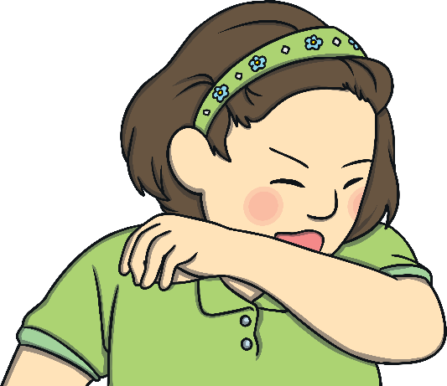
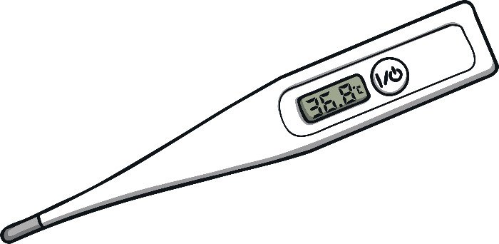
Feeling Ill
The main symptoms of COVID-19 are:
A sore throat
A high temperature
A cough
If we have any of these symptoms or someone in our house does, we need to stay at home.

Slide 8

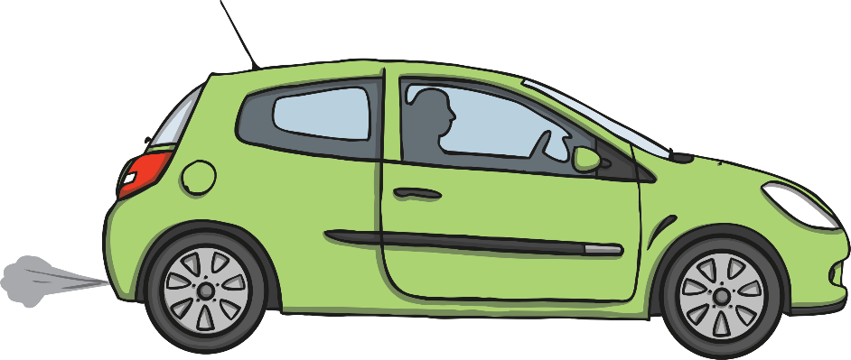
Socially Distancing
Socially distancing means staying at least two metres apart from people that we do not live with.
Or as long as a car.
Two metres is about the same length as a bed.

Slide 9


Socially Distancing
Keeping at least two metres away from people we do not live with will help to stop COVID-19 from spreading.
This is because the virus can’t spread across this distance even if an infected person coughs or sneezes.

Slide 10

Socially Distancing
It can feel strange to stay two metres apart from family and friends that we know really well. However, it's really important to do this to stop COVID-19 from spreading and making lots of people unwell.
Try to imagine that you are inside a two metre wide bubble when you are out of your house. Don’t let anyone burst your bubble! This will keep everyone safe.

Slide 11
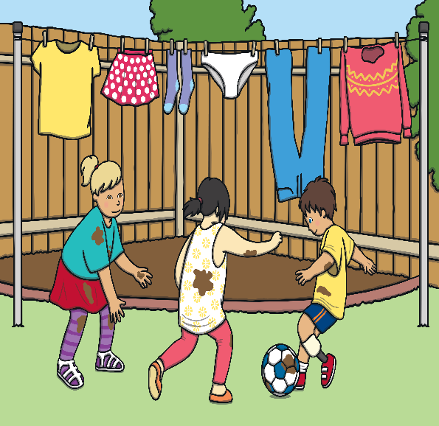
Socially Distancing Fun
You can still have lots of fun with your friends while social distancing.
You could play a game online together or challenge each other to see how long you can bounce a ball.
See if you think of other fun games to play from a distance.

