Slide 1
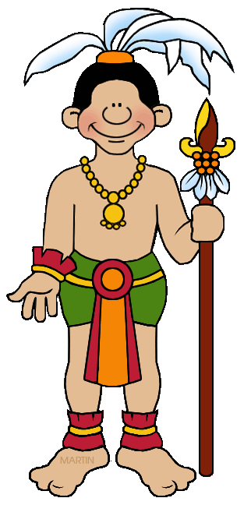
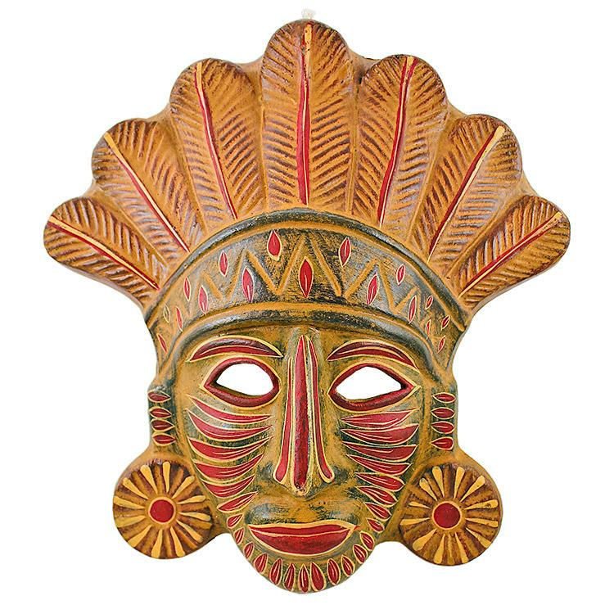
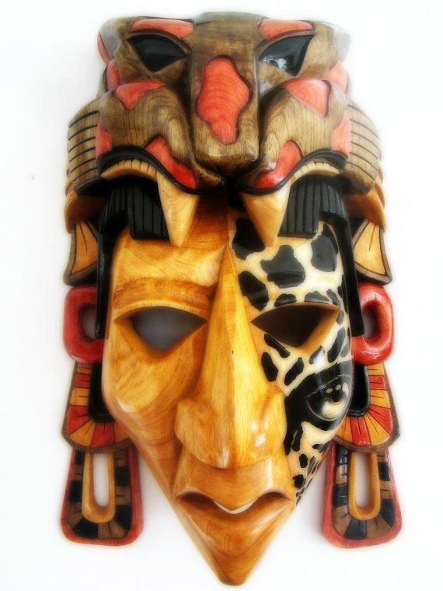
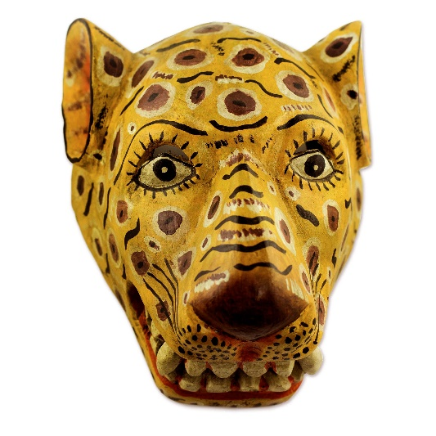
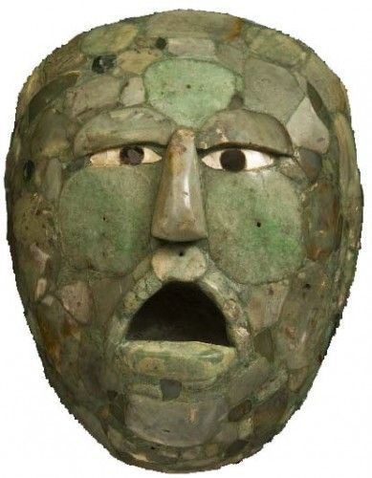
LO: To make a Mayan style mask
The Maya used masks for a variety of reasons and occasions.
These included:
- to decorate the faces of the dead
- to be worn at important events
- to be worn during battle

Slide 2
LO: To make a Mayan style mask
The importance of the masks dictated how intricate the designs were.
The most sacred Mayan masks featured complex and delicate mosaics made out of jade.
Other materials used were stone, wood, gold, shell and obsidian (a hard, dark, glass-like volcanic rock)

Slide 3
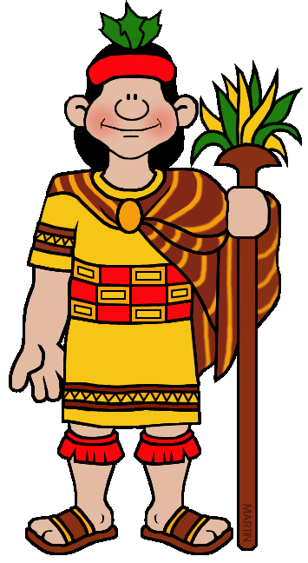
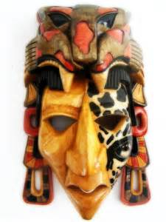
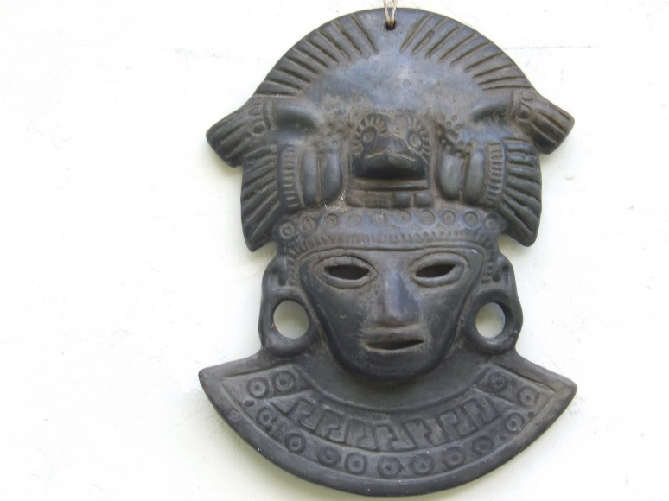
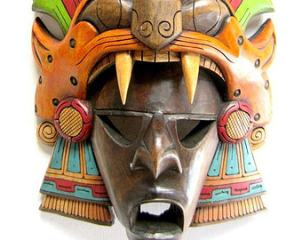
LO: To make a Mayan style mask
Some Mayan masks were worn in battle. They were usually carved from wood or stone.
They were worn for one of two reasons:
To protect the wearer during battle
To intimidate the enemy

Slide 4
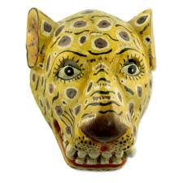
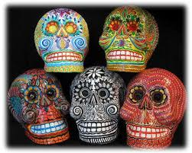
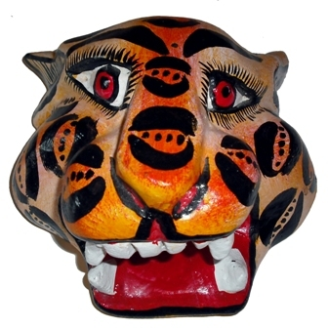
LO: To make a Mayan style mask
Other masks were designed to be worn during important events such as weddings and birth ceremonies. These masks often depicted gods or animals.
These masks used amazing designs with bright, vibrant colours painted onto wooden surfaces.

Slide 5
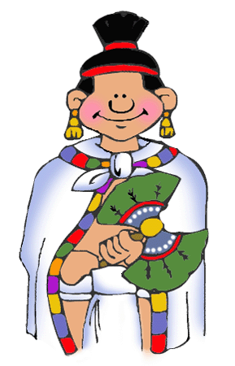
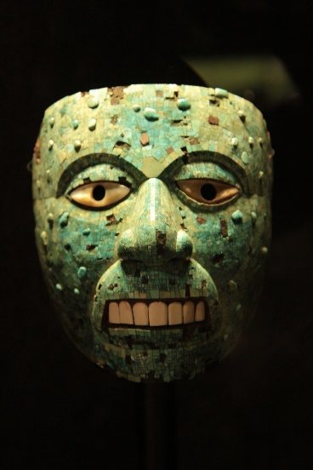
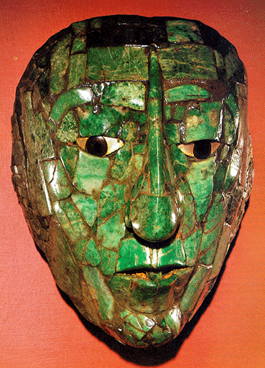
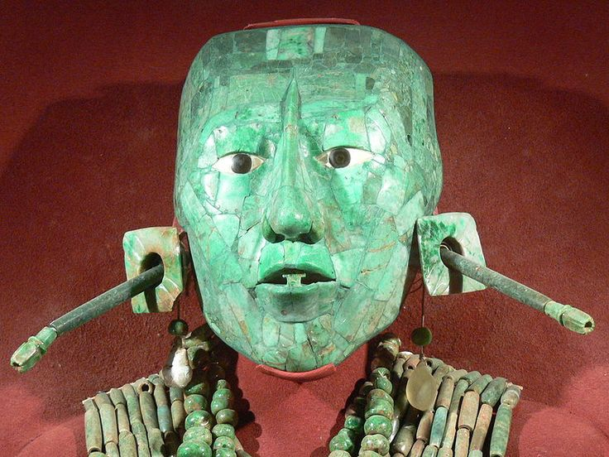
LO: To make a Mayan style mask
Death masks were the most sacred and elaborate.
These masks used a mosaic pattern of the Jade stone.
The funeral masks protected the individual on their journey to the afterlife.

