Slide 1
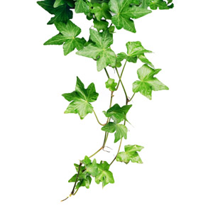
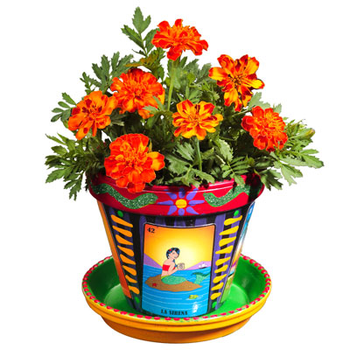
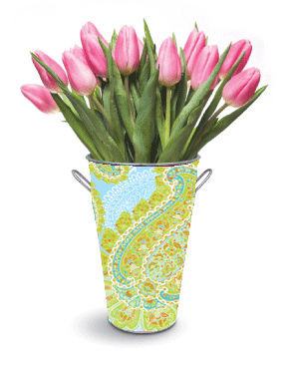
Plants: Their parts and what they need to grow
Science!
www.TheStorySeed.com

Slide 2
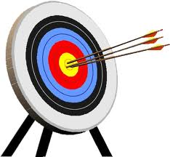
Science!
Objectives
To be able to label the parts of the plant.
To know what plants need for growth.

Slide 3
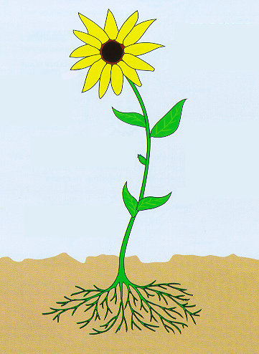
Science!
Let’s have a go at labelling this flower.
Petals
Stem
Bud
Leaves
Roots

Slide 4
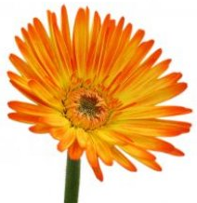
Science!
What plants need to
grow

Slide 5
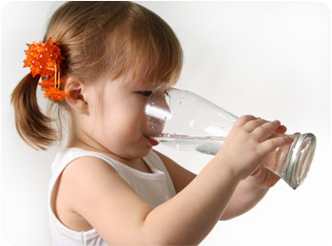
Science!
We need to eat food and drink water to grow.

Slide 6
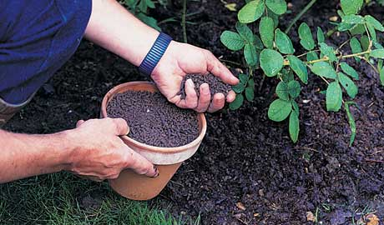
Science!
Plants need water too, just like us. But plants don’t eat anything. They make their own food.
?
So why do plants need fertiliser?

Slide 7
Science!
Fertilisers have nutrients in them. Plants use the nutrients to help them make their food.

Slide 8
Science!
Let’s look at the things plants need in order to grow properly.

Slide 9
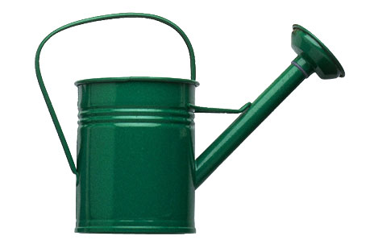
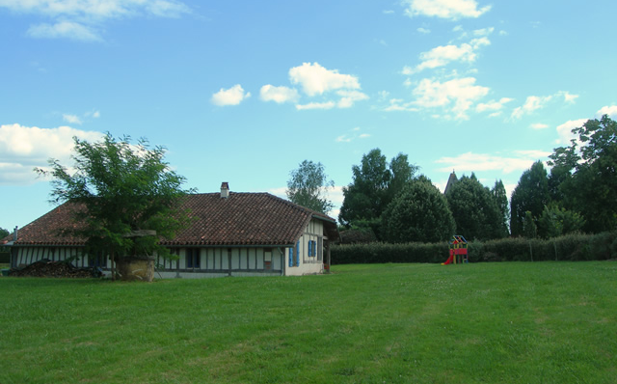
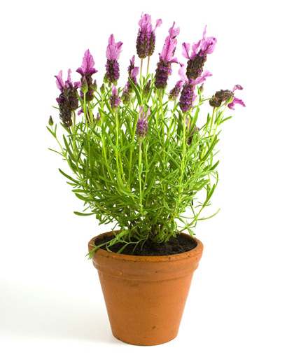
Science!
What can you
see here?
Water
Light
Warmth
Space
Nutrients

Slide 10
Science!
Light
Plants use light to make their own food. When plants make their food, this is called photosynthesis.
Photo means light.
Synthesis means making.
So, plants make food by using light.

Slide 11
Science!
Warmth
Plants will die if the temperature is too low (if it’s too cold).
Think about what happens to plants and trees in the winter season.

Slide 12
Science!
Nutrients
Plants use nutrients to help them make their food. Fertiliser contains a lot of nutrients.
Different nutrients help the plant in different ways. Some help the roots grow. Some help the flowers grow.

Slide 13
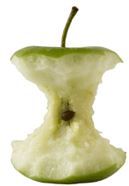
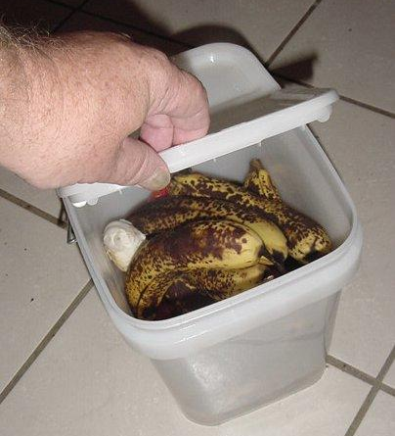
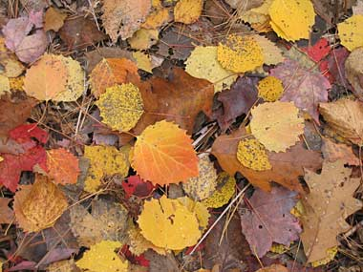
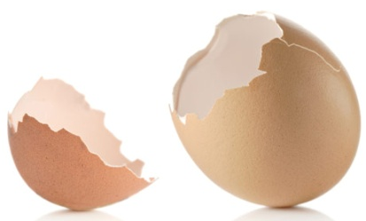
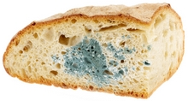
Science!
Who has a compost bin at home?
You can make your own fertiliser by leaving natural things to rot in your compost bin.

Slide 14
Science!
Water
Plants need water for photosynthesis.
Who can remember what photosynthesis is?

Slide 15
Science!
Water
The water also dissolves the nutrients so that they can be can be taken into the plant by the roots.

Slide 16
Science!
Space
Plants need space so that they have enough room to grow.

Slide 17
Science!
STOP AND
THINK
OK, can you list the 5 things plants need to grow?
Light
Warmth
Water
Nutrients
Space

