Slide 1
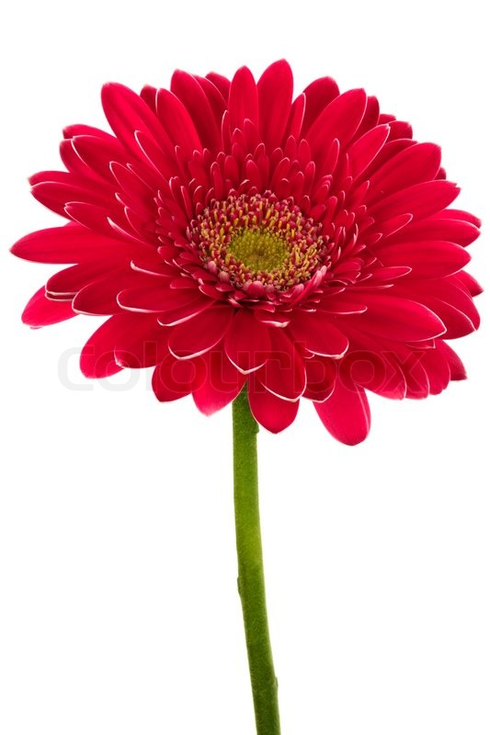
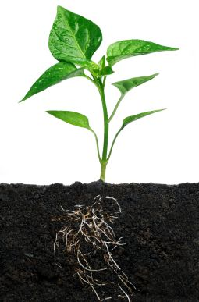
What Do Plants Need?
Quiz

Slide 2
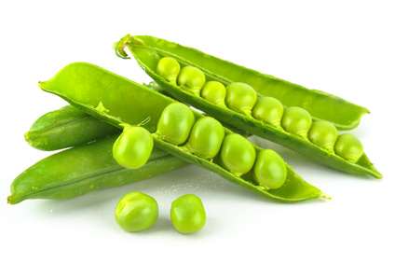
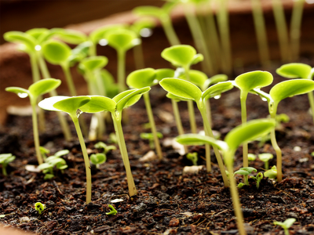
This is a quiz to help you learn about plants and what they need to grow strong and healthy.

Slide 3
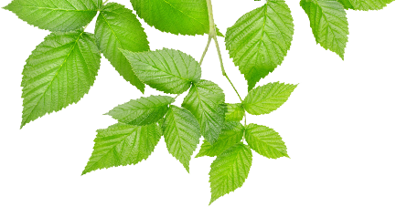
There are 17 questions altogether
Good Luck!

Slide 4
Plants
do not make their own food but instead get it from the soil
make their own food

Slide 5
2. Plants make their food in …
the roots
the leaves

Slide 6
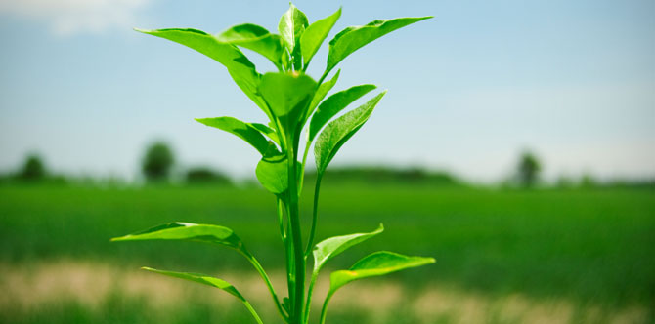
3. A plant makes food from 2 main ingredients. These are
water and a gas in the air called carbon dioxide
water and soil

Slide 7
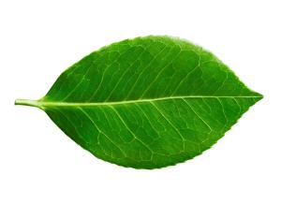
4. The Carbon dioxide gas comes into the leaves from
tiny holes underneath the leaves
the stem

Slide 8
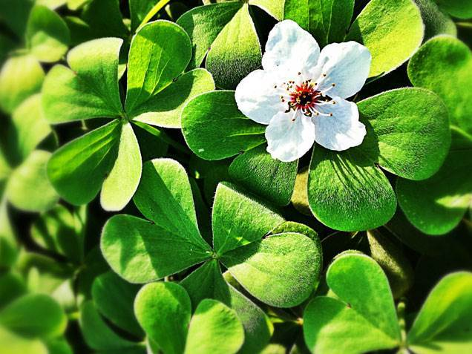
5. The plant needs energy to turn water and gas into food. This energy comes from
sunlight
electricity

Slide 9
6. The leaves of the plant are like solar panels, stretched out to capture the sunlight and use its energy to make food. The green chemical that does this is called …
asparagus
chlorophyll

Slide 10
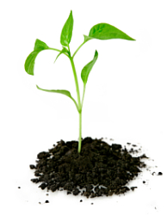
7. To stay healthy, a plant also needs minerals, rather like we need vitamins. A plant gets these minerals from …
the air
the soil

Slide 11
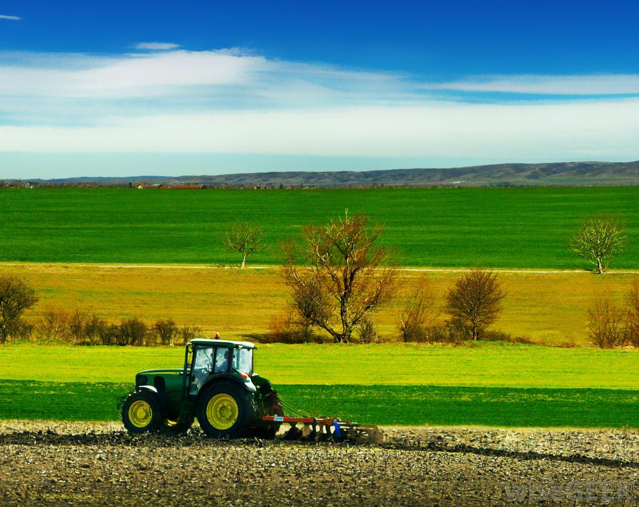
8. Healthy soil has lots of minerals and nutrients for plants. Farmers and gardeners add extra nutrients to soil by …
digging in animal dung or artificial fertilisers
spraying water onto it

Slide 12
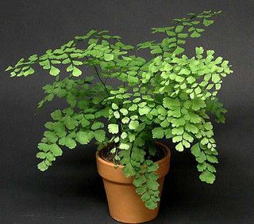
9. A potted plant can sometimes run out of minerals and nutrients
because it has used them all up
because it needs more than other plants

Slide 13
10. Sometimes a potted plant gets too big for its pot and
so it needs extra water
this can stop it growing

Slide 14
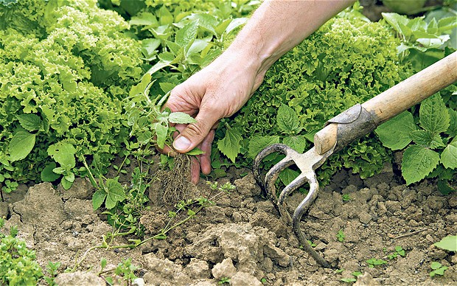
11. Weeds are just plants that grow in places they are not wanted.
Most gardeners clear away weeds so they don’t crowd in on plants and take some of their water and light.
Most gardeners don’t mind too much about weeds as they don’t do any harm.

Slide 15
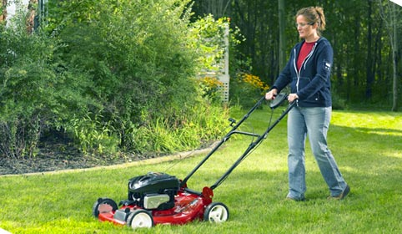
12. Grass needs cutting …
all the year round
much more in the summer months

Slide 16
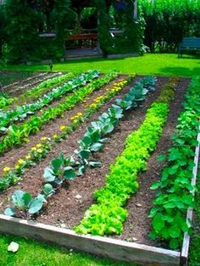
13. The summer months are …
warmer and the sunshine is stronger
colder and darker

Slide 17
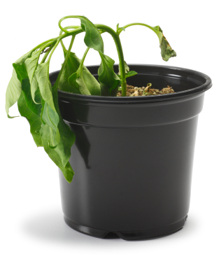
14. Plants become unhealthy or even die if they do not have the right requirements. If a plant becomes droopy like this one, it is said to be …
sulking
wilting

Slide 18
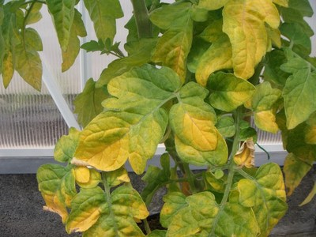
15. Another sign of an unhealthy plant is when the leaves change colour. This problem is called …
yellowing
colouring

Slide 19
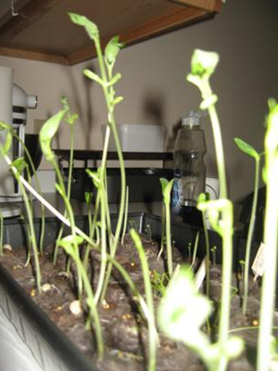
16. Sometimes plants grow too tall and become weak and spindly. Plants with this problem are said to be …
leggy
floppy

Slide 20
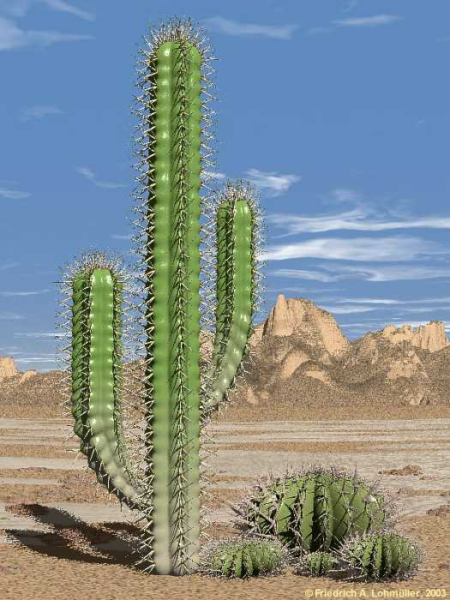
17. Plants have adapted to live all over the planet. Desert plants save water by …
Not using it to make as much food as other plants
Storing it in their thick fleshy stems.

