Slide 2
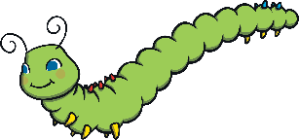
Click the leaves for clues
1
I am long with lots of legs.
2
I will turn into another minibeast!
3
I was born from an egg.
What am I?
Reveal
I am a caterpillar!
Next

Slide 3
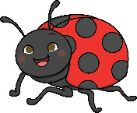
Click the leaves for clues
1
I have 6 legs.
2
I can fly.
3
I have spots.
What am I?
Reveal
I am a ladybird!
Next

Slide 4
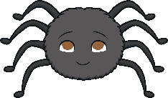
Click the leaves for clues
1
I like to spin webs.
2
I have 8 legs.
3
I like to eat small insects.
What am I?
Reveal
I am a spider!
Next

Slide 5
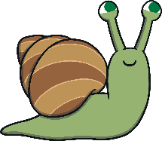
Click the leaves for clues
1
I carry my home with me.
2
I don’t have any legs.
3
I leave a slimy trail.
What am I?
Reveal
I am a snail!
Next

Slide 6
Click the leaves for clues
1
I lay eggs on plants.
2
I have 4 wings.
3
I came from a chrysalis.
What am I?
Reveal
I am a butterfly!
Next

Slide 7
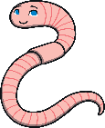
Click the leaves for clues
1
I have no legs.
2
I like to burrow.
3
I like to wriggle around.
What am I?
Reveal
I am a worm!
Next

Slide 8
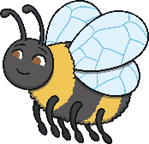
Click the leaves for clues
1
I am very busy!
2
I am striped.
3
I make honey.
What am I?
Reveal
I am a bee!
Next

Slide 9
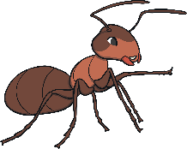
Click the leaves for clues
1
I am very strong.
2
I live in a nest.
3
I work for my queen.
What am I?
Reveal
I am an ant!

